Slide 1
Self-Contained Dye Laser Cavity for UV Sunscreen Absorbance Testing
Group 4
Bell, Ryan; PSE
Ephraim, John; EE
Zamora, Berny; EE

Slide 2
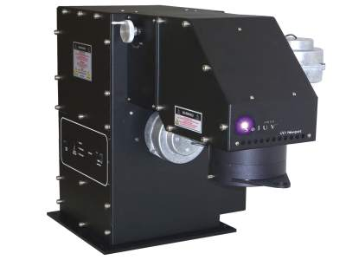
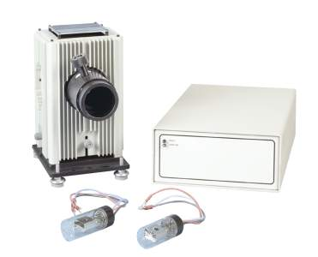
Introduction
Absorption testing
Measure optical power before and after the object in question
Typically done with arc lamps or filament bulbs

Slide 3
Goals/Objectives
 | Goal | Outcome
Output Optical Power | 1+ mW | Unknown
Laser Profile | Gaussian | N/A
Operating Time | >8 hr | 20.5 hr
Total Drawn Current | <2.8 A | >.3105 A*
Recharge Time | <12 hr | Unknown
Charge Cycles | >500 | >300
Weight | <16.5 lb | <1 lb
Volume | <6000 cm³ | 15.905 cm³**
Price | ~$1,500 | ~$1,022.36
Swappable, refillable, VIS laser dye cavity
NLO conversion from VIS to UV
Built-in VIS spectrometer and UV optical power meter
Laser and battery information displayed to user
Wavelength
Optical power
Battery percentage
Rechargeable battery
Easy to use
*from design without photodiode circuit
**optical only

Slide 5
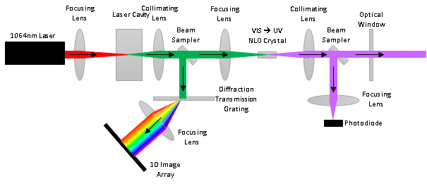

Slide 7
Cavity

Slide 8
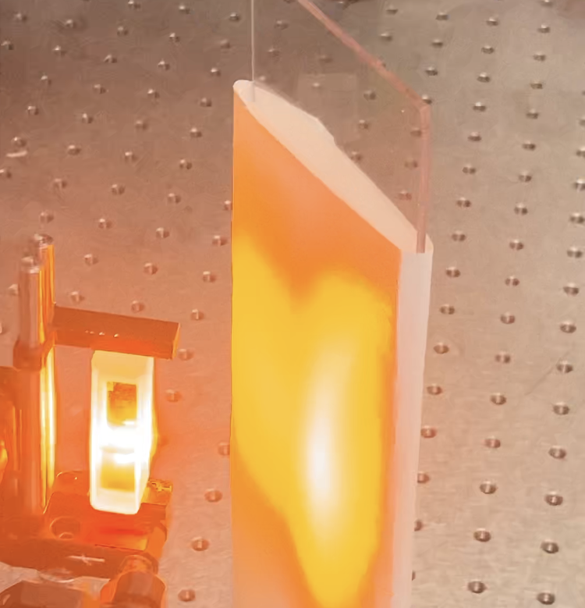
Cavity cont.
Issues
Not enough pump power
Not fast enough pulsing
At high concentration: lasing in cuvette would come out the side
At low concentration: cavity optics not strong enough
Solutions
High concentration
Use lasing output from side of cuvette
Very messy beam
Dropping dye cavity entirely
Project turns into a modular system to attach to a VIS laser

Slide 9
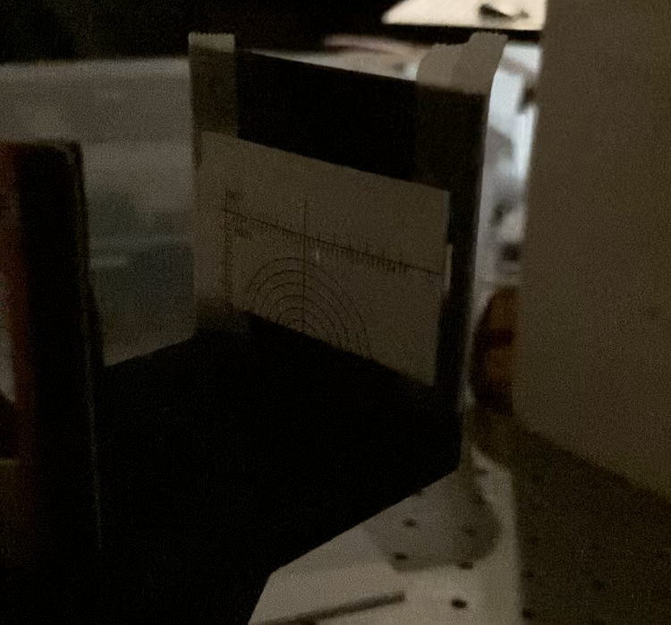
Spectrometer
Has been working optically since midterm demo for SD1
Unable to test resolution due to incomplete sensor circuit
Predicted .1150nm/pix at center and 1.035nm/pix at edges
It is predicted that some changes would be made during testing to the sensor’s longitudinal location to even out blurring from spherical aberrations

Slide 10
VIS -> UV
Tested successfully with powerful input source
Theoretically, lower input sources would still successfully produce UV light, though at lower powers
Issues
Conversion efficiency could not be tested due to limited access to pump source and oversaturation of measuring devices when reading both VIS and UV through the BBO
It is possible that some wavelengths nearing the bottom of this project’s attempted spectrum (nearing 400nm) would not work due to the BBO housing limiting accepted incident angles

Slide 11
Optical Power Meter
Light properly focused to sensor
Sensor successfully tested for response that is directly correlated to incident power
Issues
Due in part to communication errors, the part needed to mount the sensor was not acquired, and so this piece was not mountable by our system alone

Slide 12
Power delivery
The power supply will deliver power to:
Cooling system (Two fans)
Spectrometer (1-D array sensor)
Power meter (transimpedance circuit)
Microcontroller
The display.

Slide 13
Power Supply Design
Battery powered with rechargeable Li-ion batteries
Battery holder case
Voltage Regulators
Cooling System
Microcontroller power connection circuit

Slide 14
Power supply setup
Two batteries connected in parallel
Switch to turn on and off microcontroller, sensors and display.
Voltage regulators feed each component which requires power
Connection from regulators to microcontroller power circuit connection

Slide 15
Voltage regulators
The 3.3V step-down regulator using the XCL210C331GR-G IC
Connected to the 5V regulator output
Powers the MSP430FR6989 microcontroller DVCC and AVCC pins.
The IC was found through a parts supplier and the regulator was design with the aid of the datasheet directions and specifications

Slide 16
Voltage regulators
The 5V step-down/step-up regulator using the LM2698MM-ADJ/NOPB IC
Connected directly from the 3.7V batteries
Powers two fans in the cooling system and the LCD display
Designed using TI Webench Power Designer

Slide 17
Voltage regulators
The 12V step-up regulator using the XC9143B10DER-G IC
Connected directly from the 3.7V batteries
Supplies power to the transimpedance circuit for the photodiode used as the power meter as well as the 1-D array spectrometer.
The IC was found through a parts supplier and the regulator was design with the aid of the datasheet directions and specifications

Slide 18
Transimpedance circuit
Consists of photodiode connected connected to op amp with a feedback capacitor and bypass capacitors.
It was tested with 650 nm light. The optical power and voltage were directly proportional.
The transimpedance circuit was completely built but was not soldered and could not record the video in time for the demo

Slide 19
Image sensor
The image sensor included 5340 elements across each line
Each line has a different sensitivity to light of uniform color temperature
The typical output signal frequency is 1 MHz and most pins required this frequency
Could be in bit clamp mode or line clamp mode

Slide 20
Code for Image Sensor
Repetitively samples voltage and converts it to integer
Repetitively converts ADC value to float and then multiplies it by the gain
Highest value is left after loop
Position in the array determines the position along the x-axis to find wavelength
Display as integer on the LCD

Slide 21
Code for Transimpedance Circuit
Converts ADC converted value to float and then multiplies it by the gain.
The gain is dependent on the frequency
Using laser with known frequency and the responsivity provided by the manufacturer
Display as float on the LCD

Slide 22
Issues interfacing with the image sensor
The timing of the pulse signals were too small and the microcontroller could not reliably create those signals
Large sinusoidal signals produced by the PWM could damage the component
Op amp would amplify those signals. Level Shifter may have helped but was not working by presentation

Slide 23
Display
The display only used 4 pins for data to reduce the number of output pins
The display is always left in read mode
0.5 V on the contrast pin was the optimal voltage for reading characters.

